Slide 1

Abstractive Text Summarizer

Slide 2

Problem Statement
A lot of information is available on the internet.
Sometimes, the information is available in huge amounts of text, while we want simple explanations.
Customer’s reviews about a product or a company.
Long news articles.
Gigantic theories and thesis.

Slide 3
Literature Survey
After reading, analysing, understanding a few research papers, following points were extracted:-
Steps to achieve the goal.
Working and usage of different algorithms.
Mathematics and knowledge that was needed.

Slide 4
Working
Dataset Acquirement
Pre-processing
a. Cleaning
b. Tokenization
c. Word embedding
d. Vectorization
Design Encoders and Decoders
Tackle limitations – Attention Mechanism
Train and save model
Pass custom inputs and rate.

Slide 5
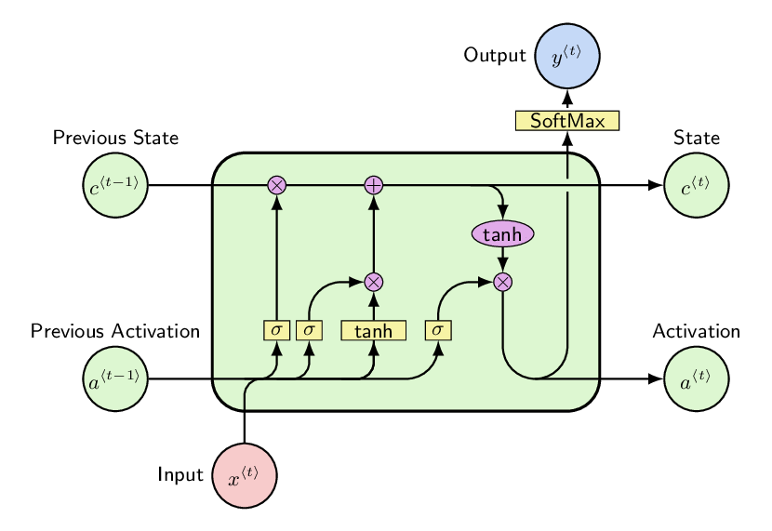
Long Short Term Memory
It is a variant of Recurrent Neural Networks.
It has the capacity to store more amount of Important words in a sentence.
It was especially designed for nlp purposes, such as autofill, fill in the blanks, etc.

Slide 6
Encoders
The Encoder-Decoder architecture is used to solve Seq2Seq problems.
An LSTM Encoder reads the entire input sequence where at each timestep, one word is fed.
It then processes the information at every timestep and captures the context present.
Internal State
Encoder
Decoder
Input
Output
h1
h2
h3
h4
Initial state(null or randomized vector)
h0,c0
LSTM
h1,c1
LSTM
h2,c2
LSTM
h3,c3
LSTM
h4,c4
Final State
x1
x2
x3
x4

Slide 7
Decoders
Decoder is also an LSTM Network.
The decoder is trained to predict the next word in the sequence given the previous word.
<start> and <end> are special tokens to initiate and terminate the decoder.
y1
y2
y3
end
Initial state(Final state of encoder)
h4,c4
LSTM
s1,c1
LSTM
s2,c2
LSTM
s3,c3
LSTM
Start
y1
y2
y3

Slide 8

Attention Mechanism - Intro
Even though LSTMS capture ample amount of information in a sentence, they still fail at specific sentences.
Attention mechanism to the rescue.
Attention Mechanism focuses on the important parts of the sentence, using a lot of mathematics.

Slide 9
Attention Mechanism - Working
There are various algorithms for attention mechanism
Using equations, they generate weights to each word and decide whether the word is important or not.
Concatenation.
Global and Local Attention
concatenation

Slide 10
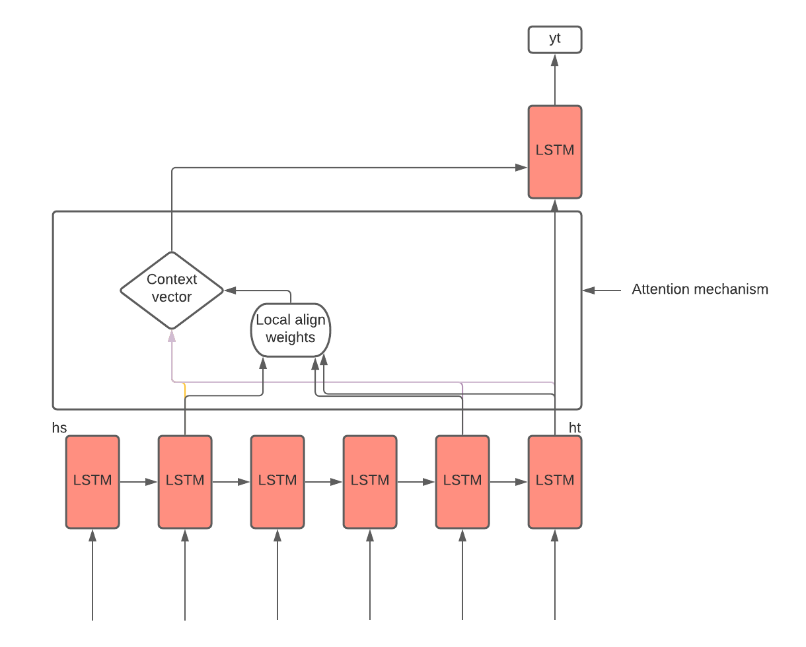
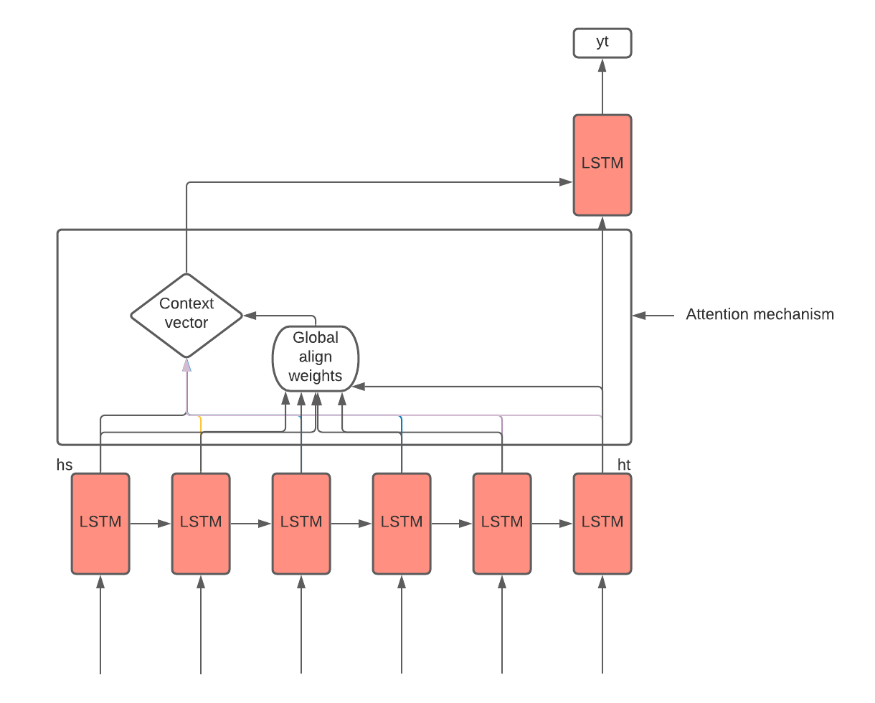
Attention Mechanism - Working
concatenation
Local Attention
Global Attention

Slide 11
Limitations
More complex than extractive summarizer.
Dataset Issues:-
Needs at least 10000 articles.
Mistakes in Dataset lead to absurd models.
Time and resource constraints (training and generating).
Topic specific.

Slide 12
Future Scope and Phase II
In the next phase, a custom dataset can be used.
Improved attention mechanisms.
Calculating Scores of the model.

Slide 13
Conclusions and Final Thoughts
Even though this particular model is way too complex to design, it is still a great practice and a huge step in nlp.
To make an accurate model, the training steps are same, everything depends on the dataset.
This project is not based on one particular principle, it is made from combining various other nlp principles.
Various other projects can be made using this method.

Slide 14
Thanks!

Slide 15
Decoders- failed animation
Decoder is also an LSTM Network.
The decoder is trained to predict the next word in the sequence given the previous word.
<start> and <end> are special tokens to initiate and terminate the decoder.
y1
y2
y3
end
Initial state(Final state of encoder)
h4,c4
LSTM
s1,c1
LSTM
s2,c2
LSTM
s3,c3
LSTM
Start

